Slide 1
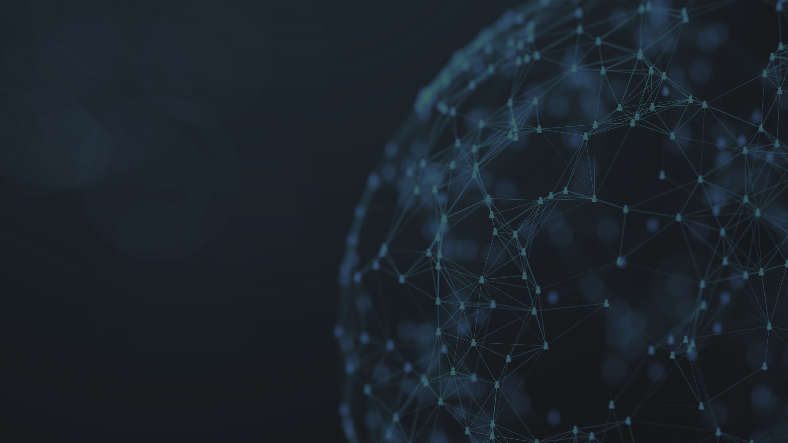
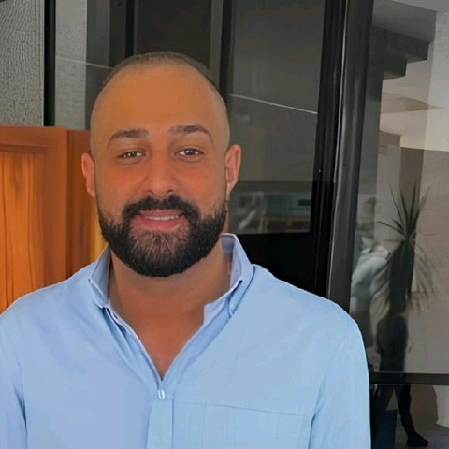
Andrew Ashraf Bassily
DevOps Enginner
DEPI-ASK
Intelligent Chat Application
Subtitle: Integrating Python, Flask, Docker, Ansible, Jenkins, and Nginx

Slide 2
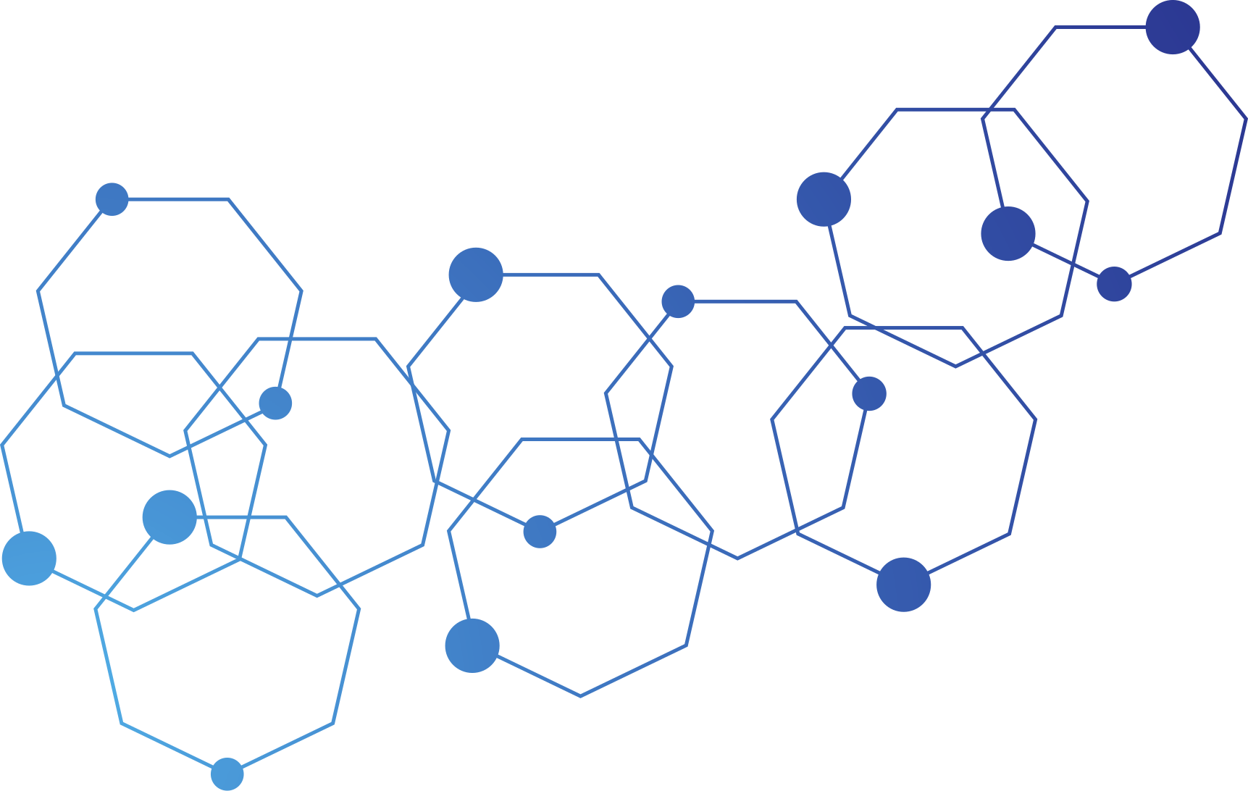


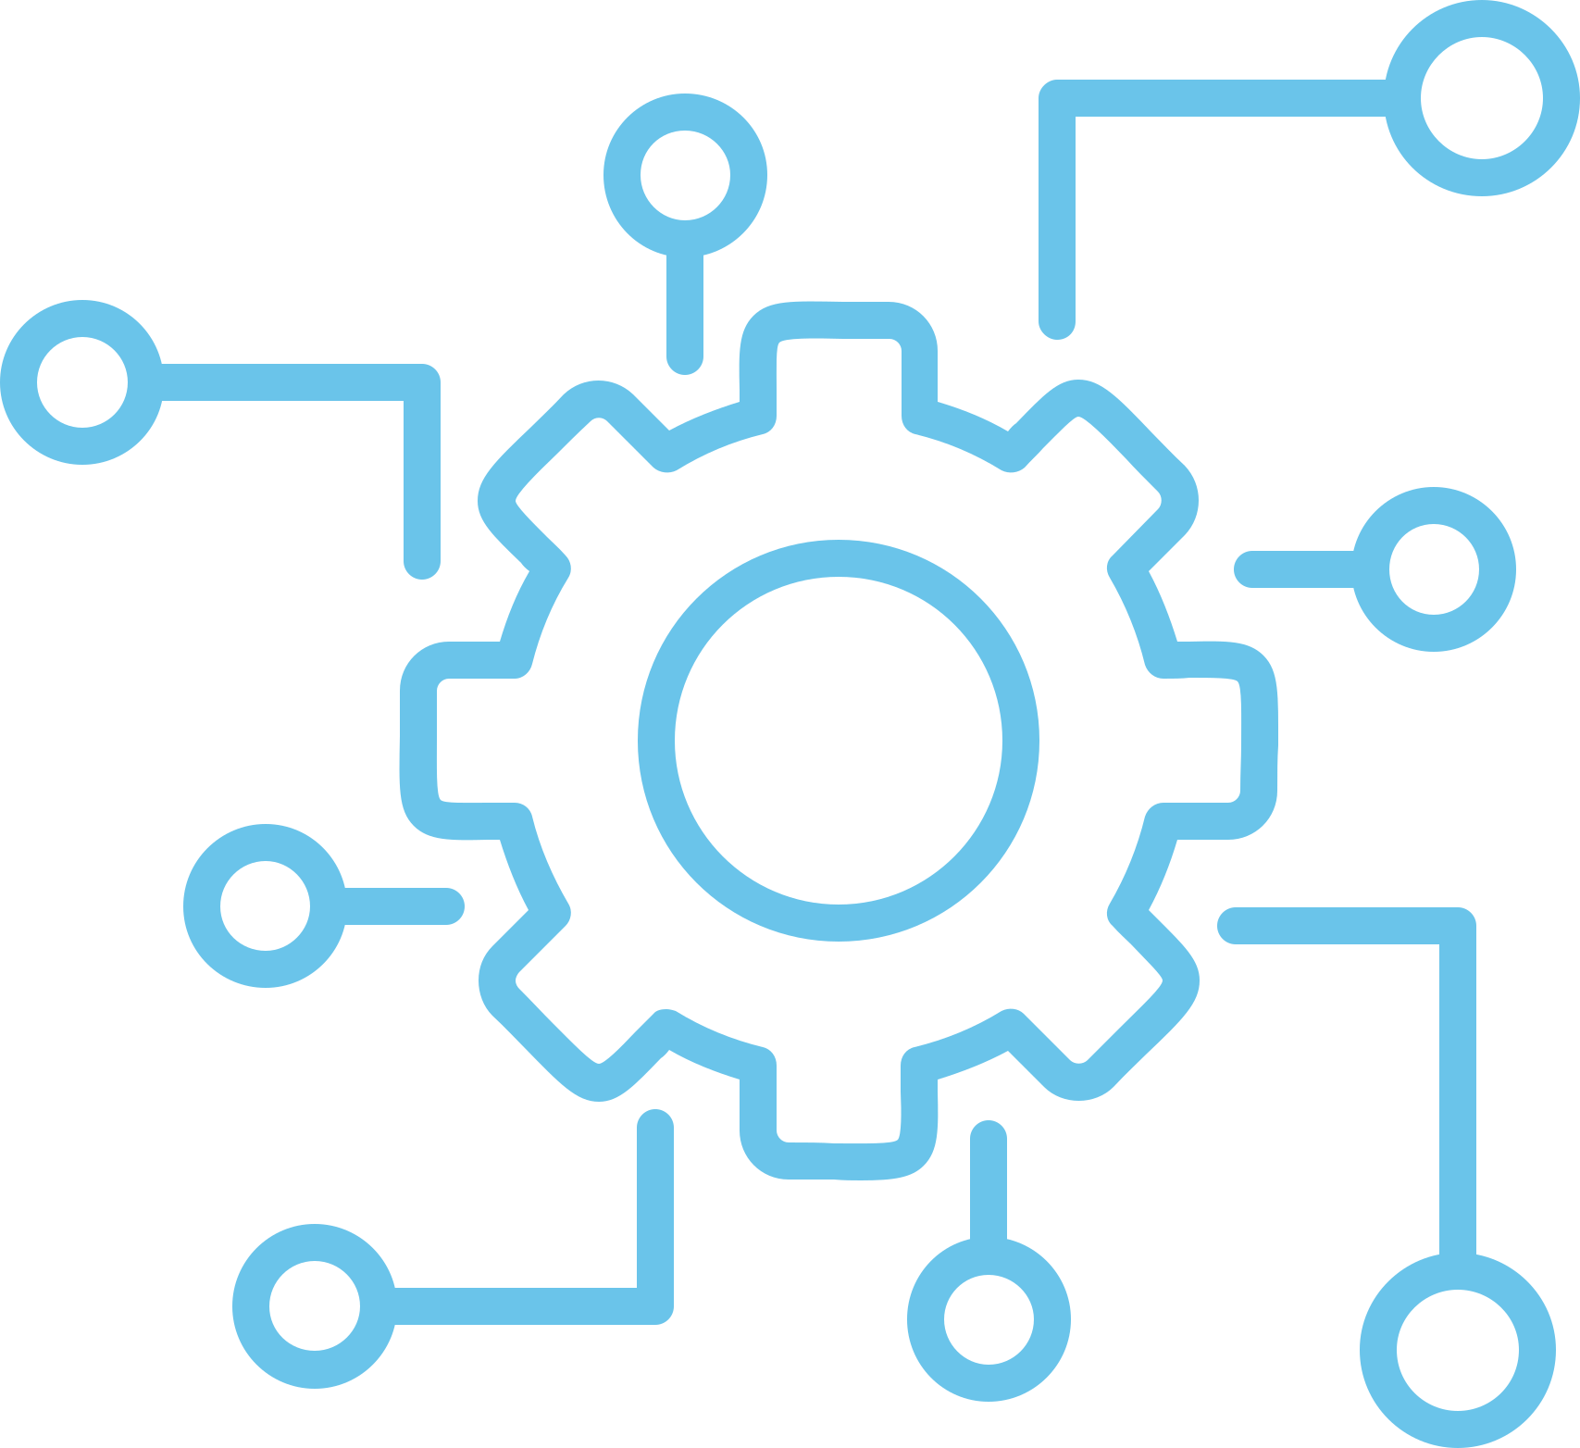
Project Overview
Project Goal
Project Goal: Develop DEPI-ASK, a chat application leveraging ChatGPT via RapidAPI, while implementing DevOps best practices for efficient development, testing, deployment, and monitoring.
Key Objectives:
Automate infrastructure setup
Simplify deployments with containerization
Ensure continuous integration and delivery (CI/CD)

Slide 3

Tech Stack Overview
Backend:
Developed using Python and Flask framework.
API Integration: ChatGPT integrated through RapidAPI.
DevOps:
Containerization: Docker used for building, shipping, and running the application in consistent environments.
Reverse Proxy: Nginx implemented for traffic routing and load balancing.
Application Server: Gunicorn used to serve the Flask application efficiently in production.
Configuration & Deployment: Ansible automates server setup, configuration, and deployment.
CI/CD Pipeline: Jenkins manages code integration, testing, and deployment, with Slack providing real-time pipeline monitoring.

Slide 4


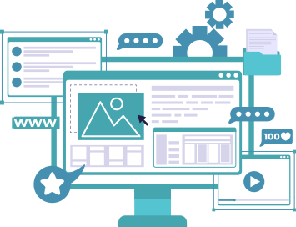
Development Process and DevOps ImplementationProject
Step 1: Application Development
Built the core functionality of DEPI-ASK using Flask, integrating it with ChatGPT via RapidAPI.
Step 2: Containerization with Docker
Dockerized the application to ensure consistency between development and production environments.
Created a Dockerfile that outlines dependencies and build instructions.
Step 3: Nginx and Gunicorn for Production
Configured Nginx as a reverse proxy to route requests to Gunicorn, improving application performance.
Step 4: Infrastructure Automation with Ansible
Used Ansible to automate server setup (installing dependencies, configuring Nginx, and starting the Docker container).
Step 5: CI/CD Pipeline with Jenkins
Built a Jenkins pipeline that automates the build, test, and deployment of the Dockerized app.
Integrated Slack notifications for real-time updates on pipeline stages.
Rapidai
DEVOPS

Slide 5


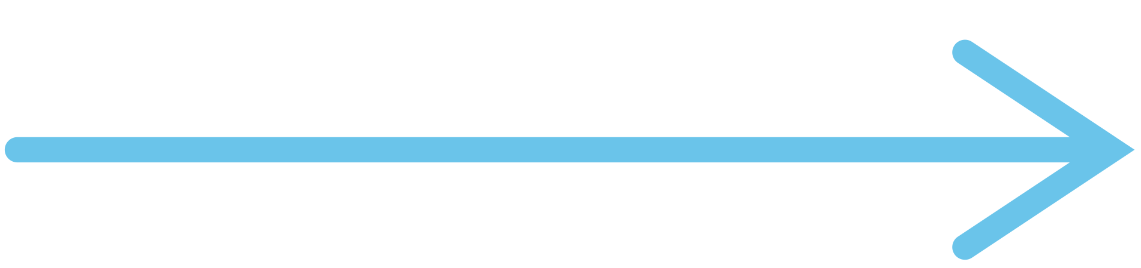
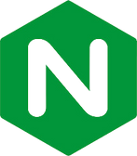
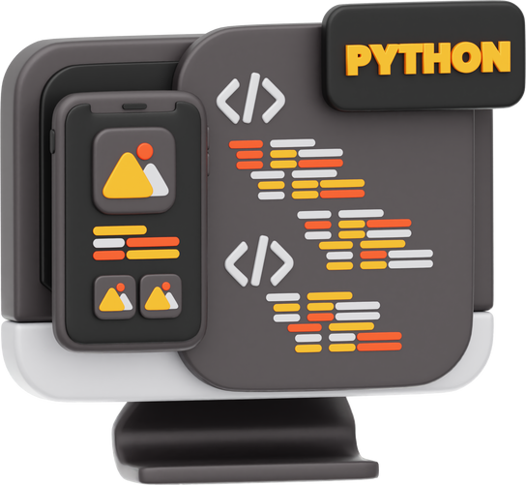
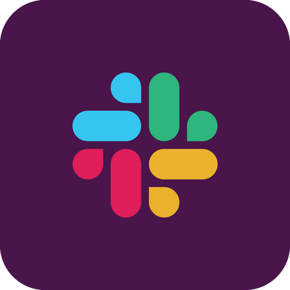


CI/CD Pipeline Workflow
Trigger
Configrations & Deploy
Github
Alert
Push
bulid
nginx
App
Slack
CI
CD
Developer
Docker
Server

Slide 6
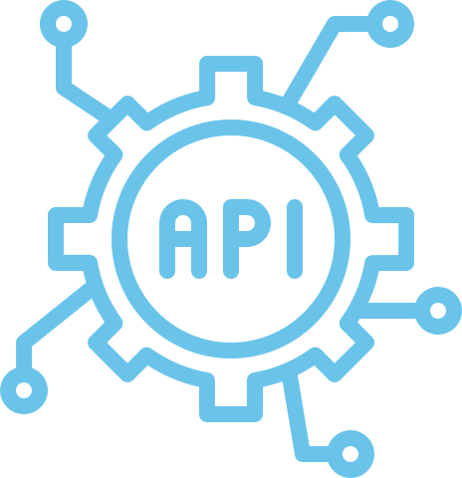
Flask Framework & RapidAPI Integration
Flask Overview: Lightweight and flexible Python web framework suitable for small to medium applications and APIs.
Simplicity: Minimal setup required, making it easy to extend and customize for various needs.
Routing and Request Handling: Provides essential features for routing, templates, and request handling.
RapidAPI Integration: Enables seamless connection to external APIs through RapidAPI, simplifying API discovery and integration.
HTTP Requests: Integration is achieved using HTTP requests (e.g., requests library) within Flask routes.
Accelerated Development: Leverages external services to enhance functionality, speeding up development and scalability.

Slide 7
Dockerization Ensuring Consistent Environments
Why Docker?
Docker ensures consistency between development, testing,
and production environments by packaging the application and its dependencies
into a container.
Steps Involved:
Created a Dockerfile that defines the environment
and dependencies for the Flask app.
Built and tested the Docker image locally and in Jenkins.
Deployed the Docker container using Ansible to ensure
consistency on the production server.

Slide 8
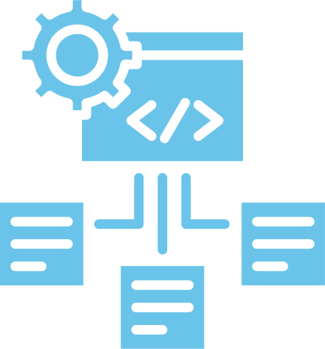
Infrastructure as Code
(IaC) with Ansible
Goal:
Fully automate the configuration and deployment process to
ensure consistency across different environments.
Key Tasks Automated:
Installing necessary packages (Docker, Nginx, etc.)
Configuring the Nginx reverse proxy
Deploying and managing Docker containers
Ensuring idempotency in server configurations
Benefits:
Reduced human error through automation
Faster and more reliable deployments
Easily repeatable processes across different environments

Slide 9
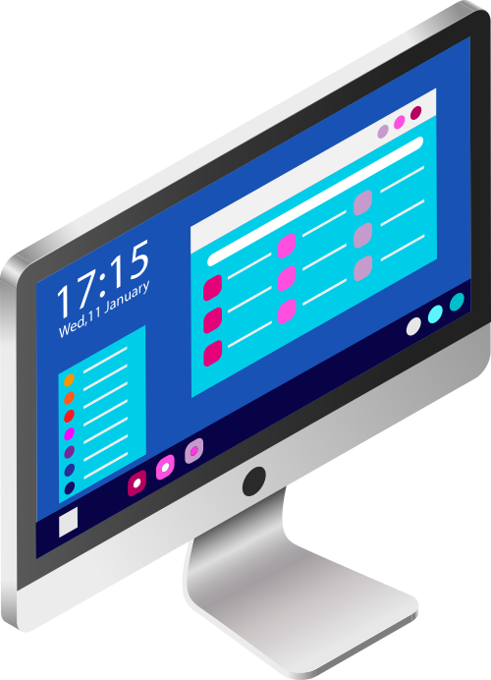
Monitoring and Notifications with Slack
Slack Integration:
Slack was integrated with Jenkins to provide real-time notifications for key stages of the pipeline (build failures, successful deployments, etc.).
Monitoring Benefits:
Immediate feedback for developers and operations teams.
Faster response times in case of issues during deployment or testing.

Slide 10

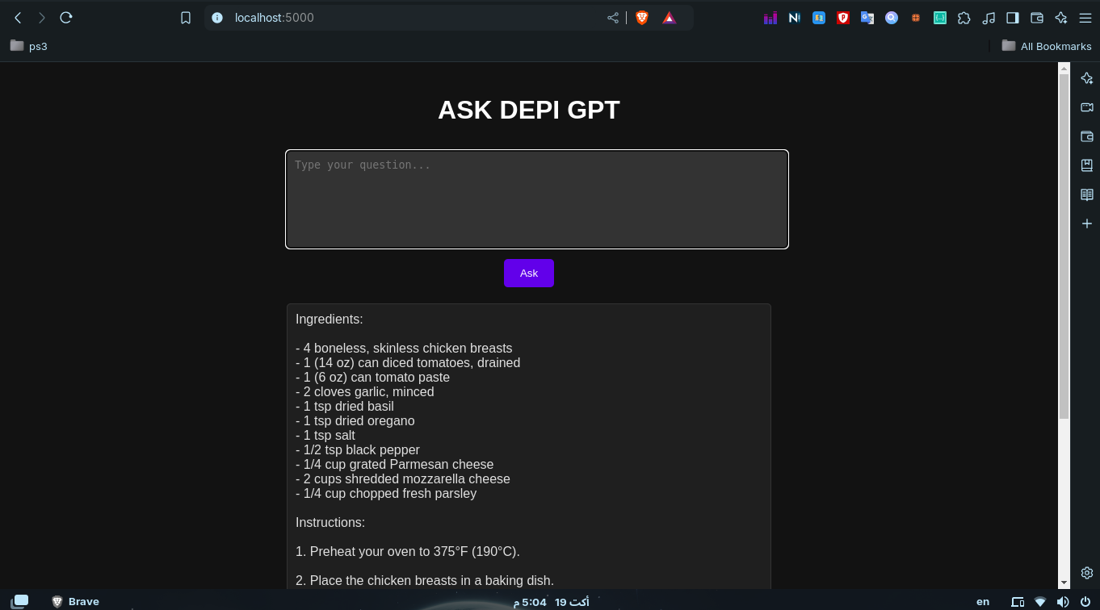

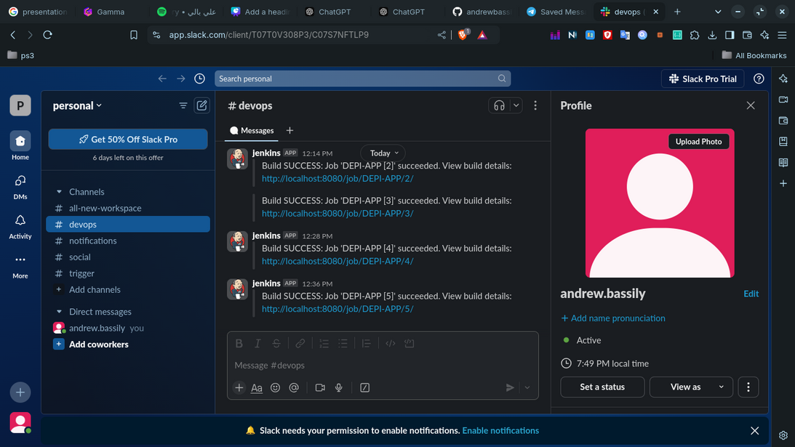
Application Demo & Slack Notifications

Slide 11
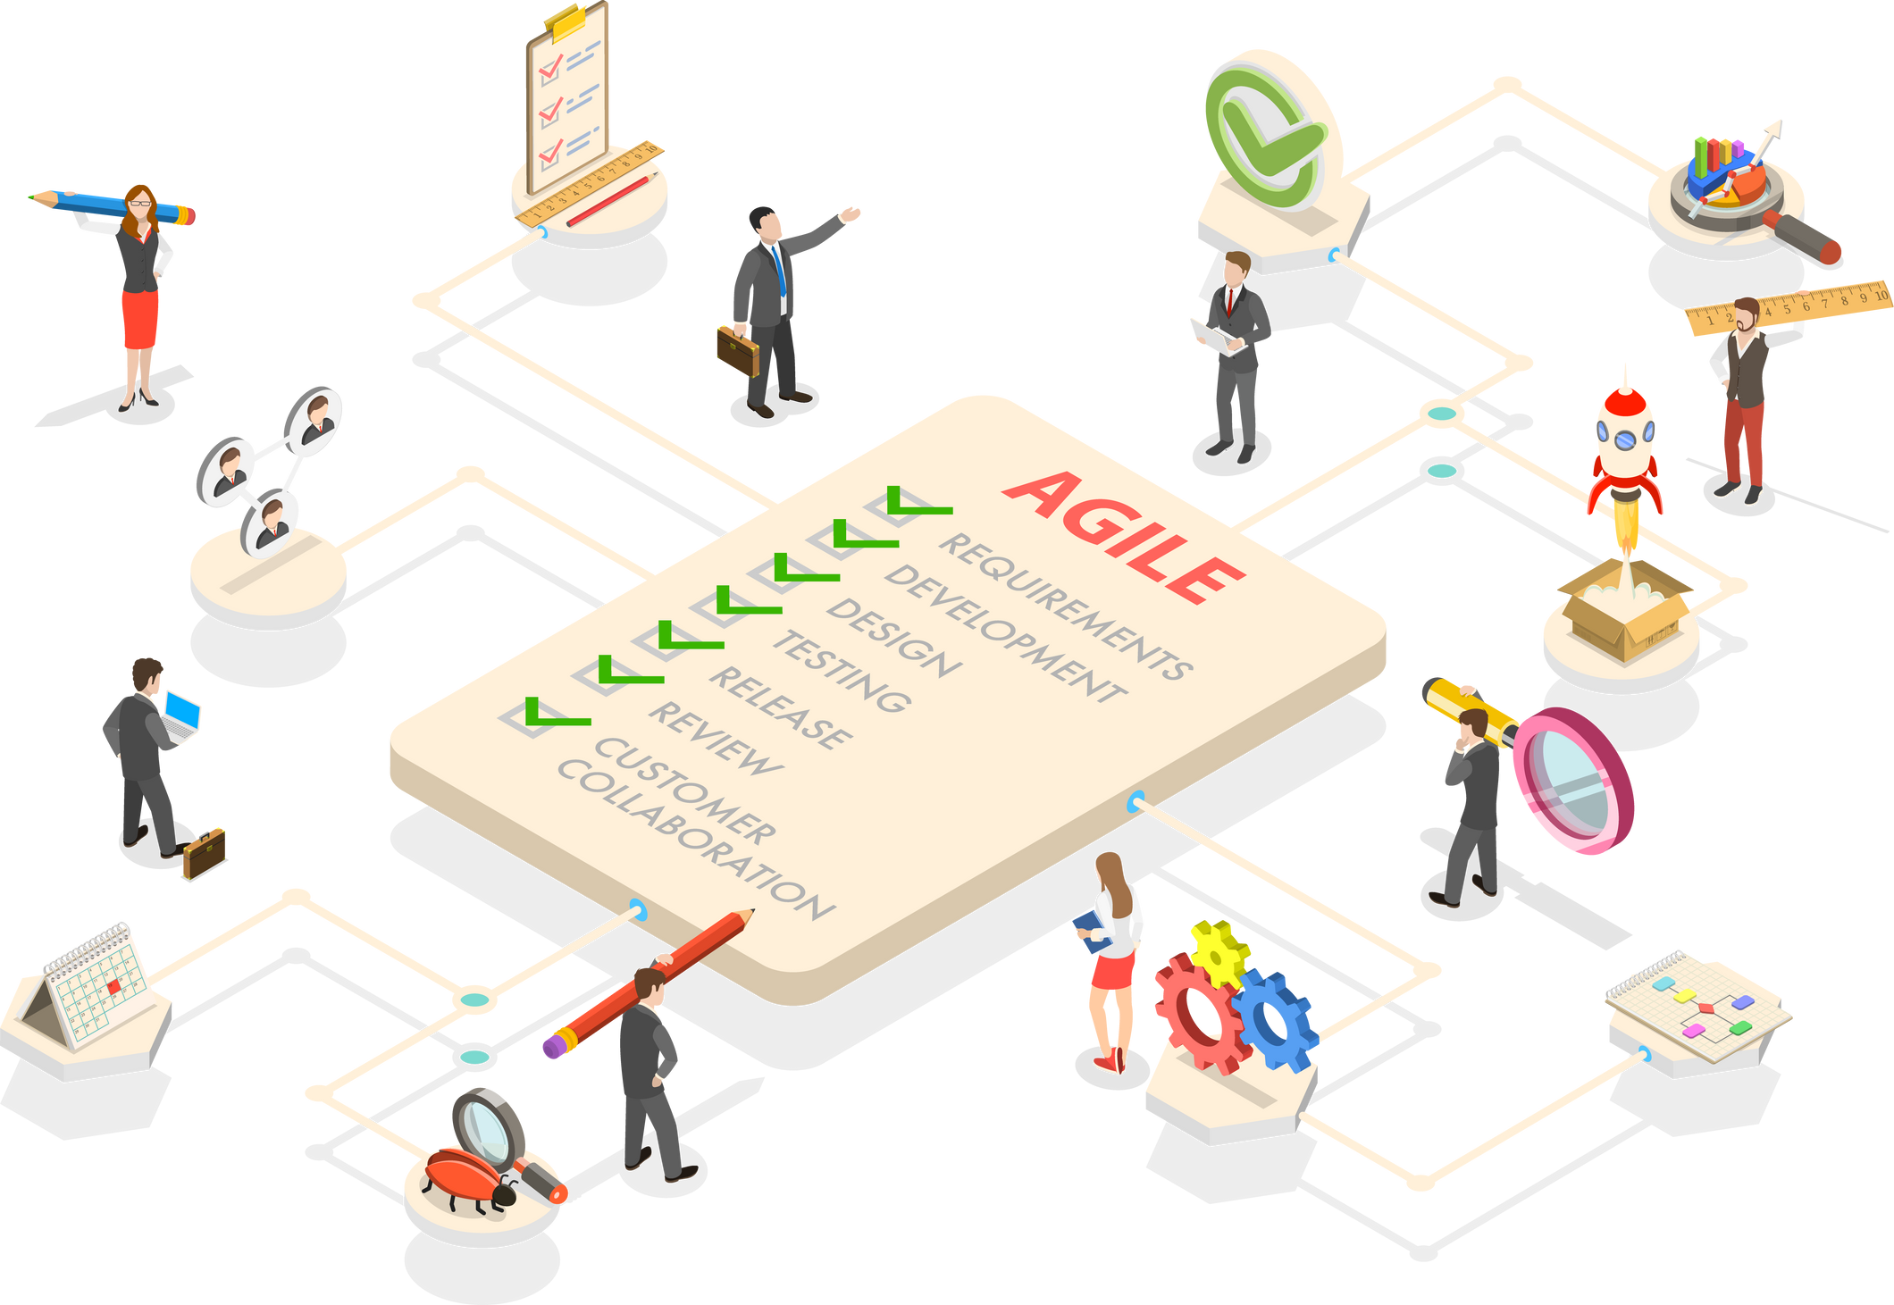
Results and Impact of DevOps Implementation
Improved Deployment Speed: Using Docker and Ansible reduced deployment time by 70%.
Increased Reliability: Automated tests in Jenkins ensure the app is fully functional before every deployment.
Consistent Environments: Docker eliminates environment discrepancies, resulting in fewer bugs and smoother deployments.
Collaborative Efficiency: Slack integration ensures fast communication between developers and ops teams.

Slide 12
Future Improvements with DevOps
Enhancing Frontend: Integrate Flask with other advanced framework like ( React )
Expand Monitoring: Integrate more advanced monitoring tools like Prometheus and Grafana for real-time metrics and performance insights.
Container Orchestration: Move towards using Kubernetes to manage containers at scale.
Security Integration: Implement DevSecOps by adding security checks into the Jenkins pipeline.
Testing Automation: Enhance test automation with tools like Selenium or pytest for more comprehensive testing.

Slide 13
Thank You!
Appreciation: Thank you for your time and attention.
Q&A Session: I welcome any questions or feedback you may have.
Contact Information:
Email: andrew.bassily@hotmail.com
LinkedIn: https://www.linkedin.com/in/andrewbassily0/

